Slide 1
Bank Reconciliation
COGNOS Reports &
OSCA Reports / SMC Reports
Presented by Leighann Pendleton, OSCA Accounting Assistance Unit Supervisor
Office of State Courts Administrator

Slide 2
Introduction to the Accounting Team
Angela D. Fisher – Section Manager
Court Review Assistance Unit | Accounting Assistance Unit
Edgar Castro-Corona – Supervisor | Leighann Pendleton – Supervisor
Joe Coy – Case Mgmt. Review | Mandy Cooper – Accountant
Brandon Walker – Case Mgmt. Review | Eric Bolzenius – Accountant
Drew Weber – Accountant | Jennifer Wickham – Accountant
Jesikkah Lanterman – Accountant | Kim Kliegel – Accountant
Leticia Volkart – Accountant | Jordan Brown – Accountant
 | Jack Black – Accountant

Slide 3
Today’s Agenda
SMC Reports
COGNOS Reports
OSCA Reports

Slide 4
Accounting Responsibilities
Minimum Operating Standard # 10: The municipal division has established procedures to generate monthly reports of municipal division activity, and the municipal division submits these reports timely to OSCA and to the city in accordance with COR 4.28 and 4.29.

Slide 5
Accounting Responsibilities
COR 4.28 | Reporting to the Office of State Courts Administrator
  Courts shall report case information to the Office of State Courts Administrator. Reporting requirements shall be approved by the State Judicial Records Committee.

Slide 6
Accounting Responsibilities
COR 4.29 | Municipal Division Reporting to the Municipality
  On or before the 15th of each month, the Municipal Division shall submit to the municipality a copy of the monthly case load summary report for the preceding month required by Court Operating Ruel 4.28. This reporting requirement shall supersede and replace the reporting requirement established by section 479.080.3, RSMo.

Slide 7
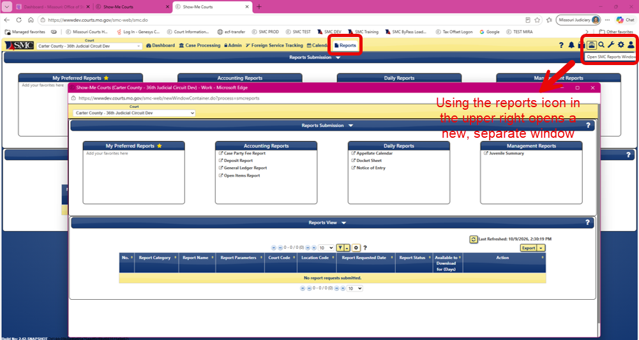
SMC Reports
Two ways to open SMC Reports

Slide 8
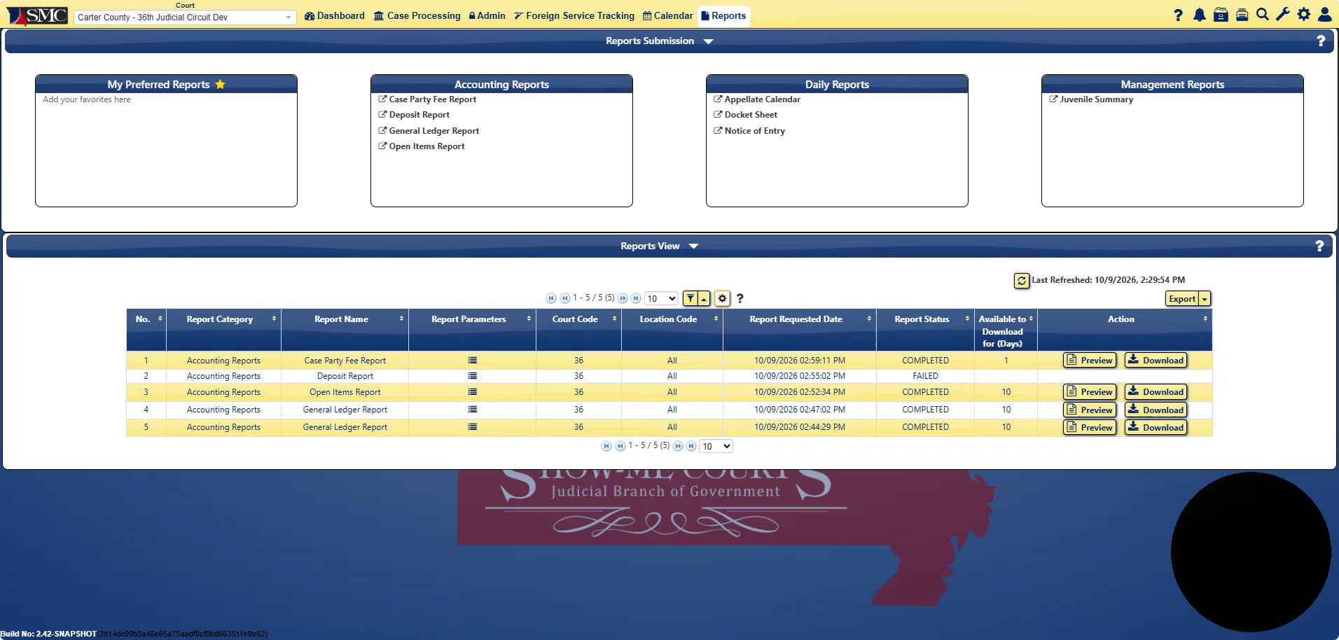
Case Party Fee Report

Slide 9
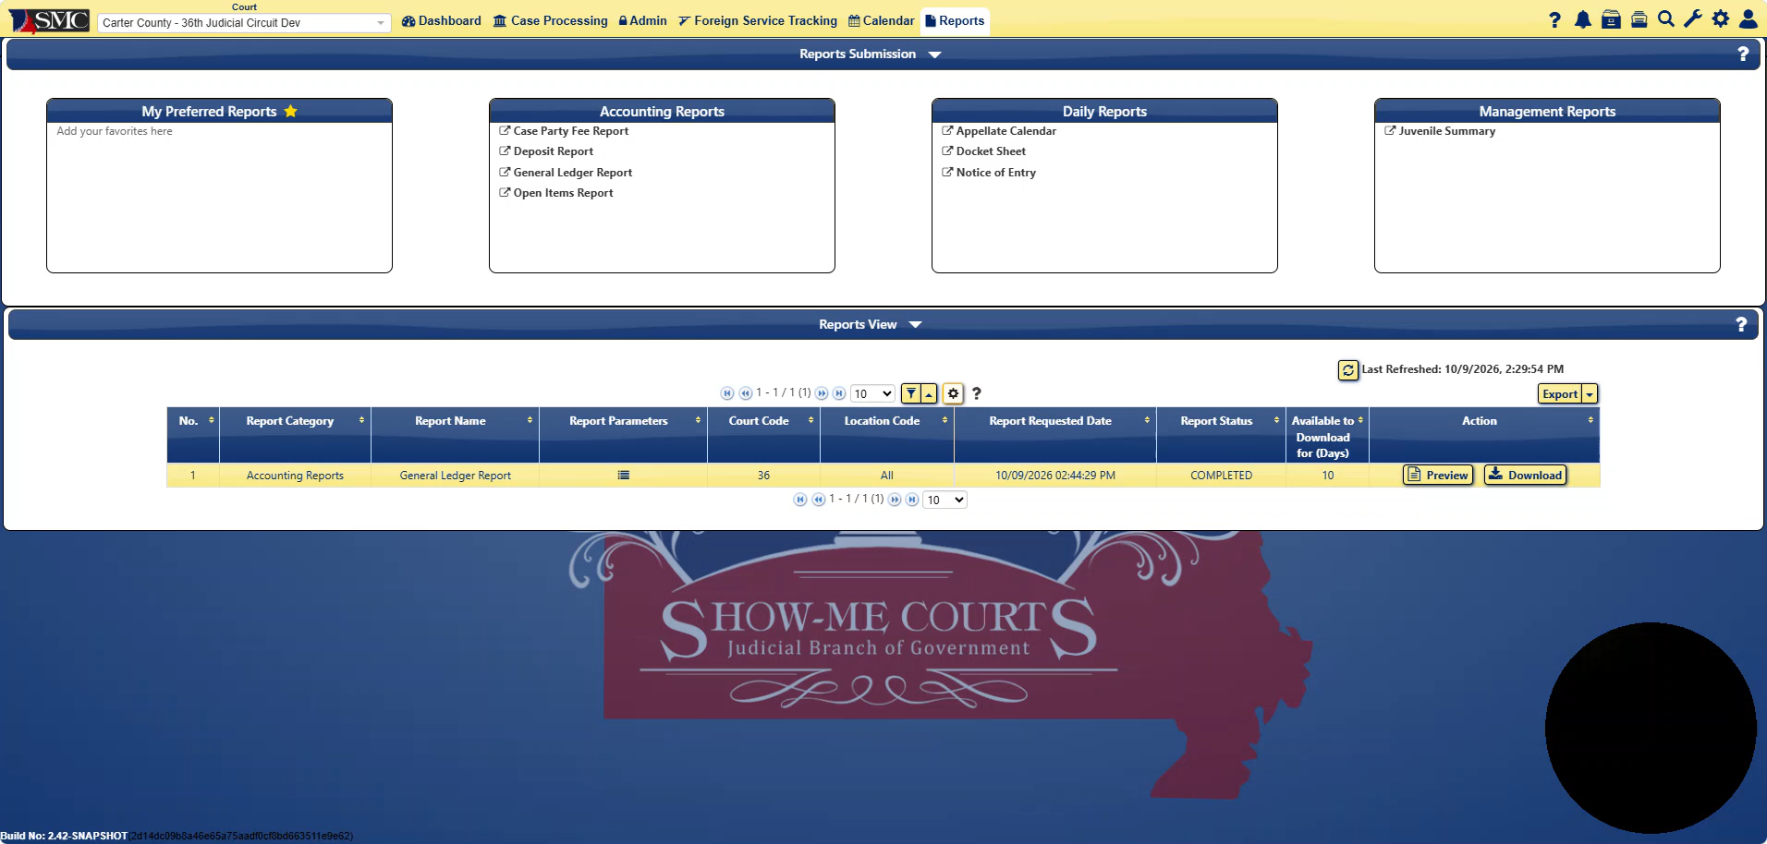
In Development – General Ledger Report

Slide 10
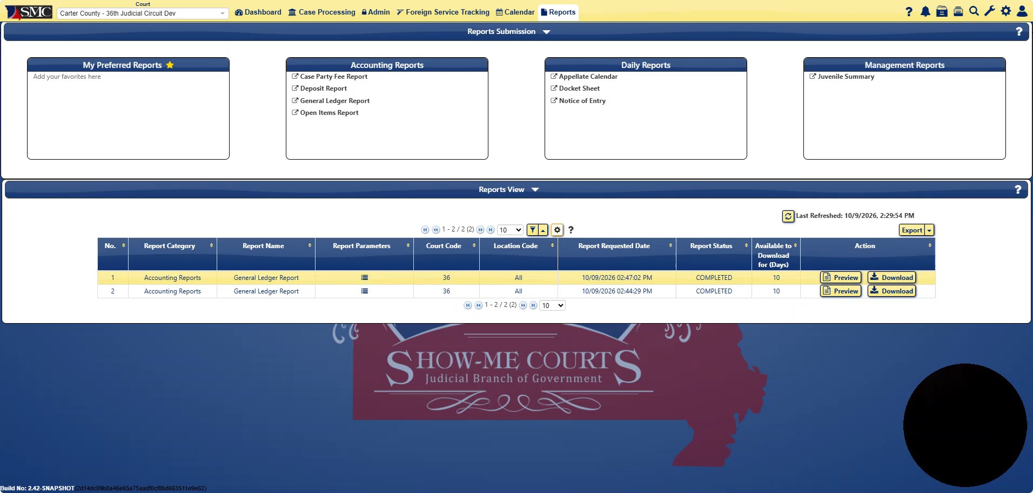
In Development – Open Items Report

Slide 11
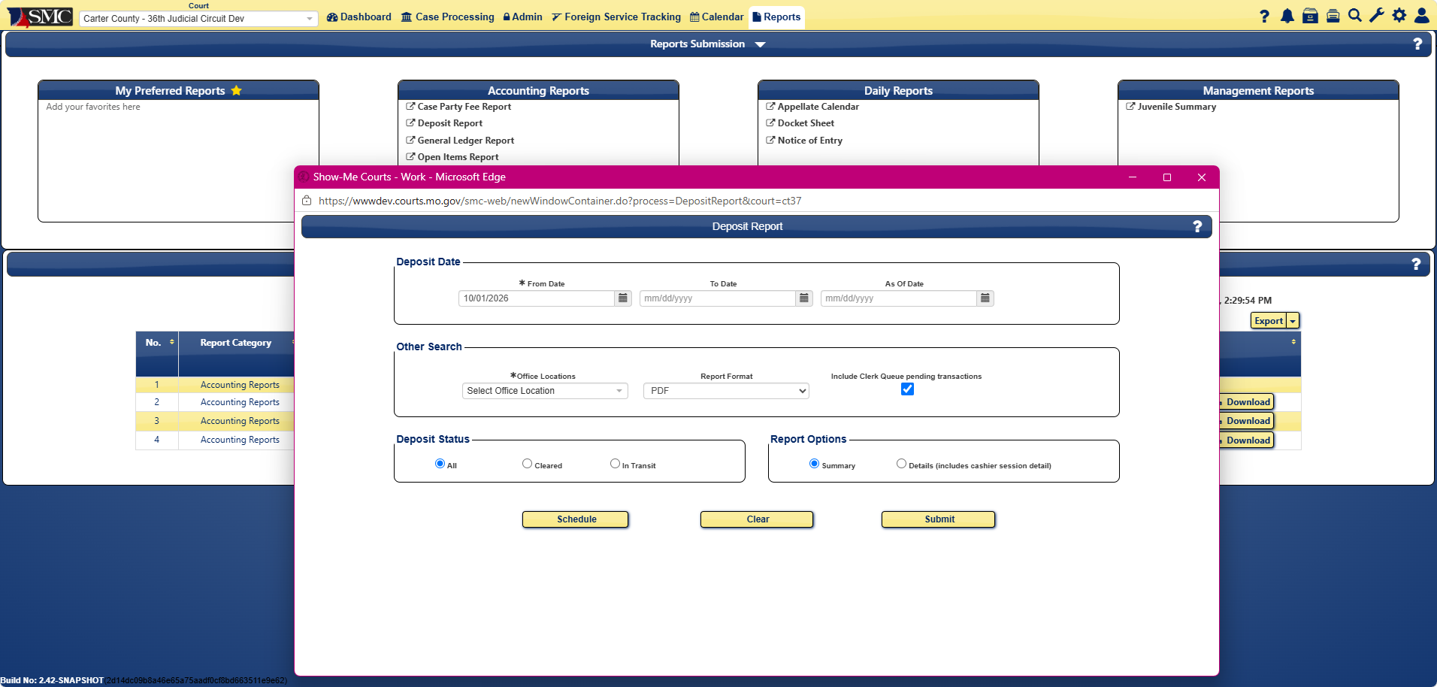
In Development – Deposit Report

Slide 12
Daily Reports
OSCA
Accounting Daily Cashier Report
Accounting General Ledger Report (Summary)
Accounting Open Items Report (Summary)
SMC
Save or Print the Pre & Post Check Registers (if checks are printed)

Slide 13
Monthly Reports
OSCA
Accounting Daily Cashier Report
Accounting General Ledger Report (Summary)
Accounting Open Items Report (Summary & Detail)
SMC
Save or Print the Pre & Post Check Registers (if checks are printed)
Aged Trial Balance Report

Slide 14
Monthly Reports
COGNOS
Automated Cashier Session Status Report (eFiling)
Fee Adjustments
Municipal Division Summary Reporting Form
JetPay (Global Payments)
Funding Report
Check Returns
Credit Report

Slide 15
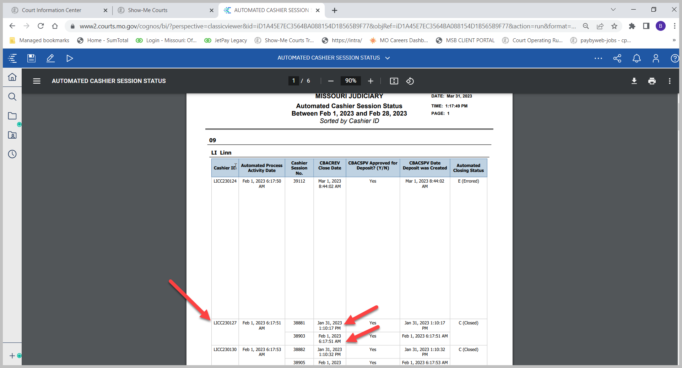
COGNOS – Automated Cashier Session Status Report
Documents any Automated deposits on the bank statement that are split into more than one cashier session in Show-Me Courts.
Team Content\Accounting\ Management\Automated Cashier Session Status
Select the Circuit Code then location code for which locations you would like to run reports for.
Sort Options-Sort by Cashier ID to find sessions that have been forced closed.
Select Beginning Date and end dates depending on time frame you want displayed.

Slide 16
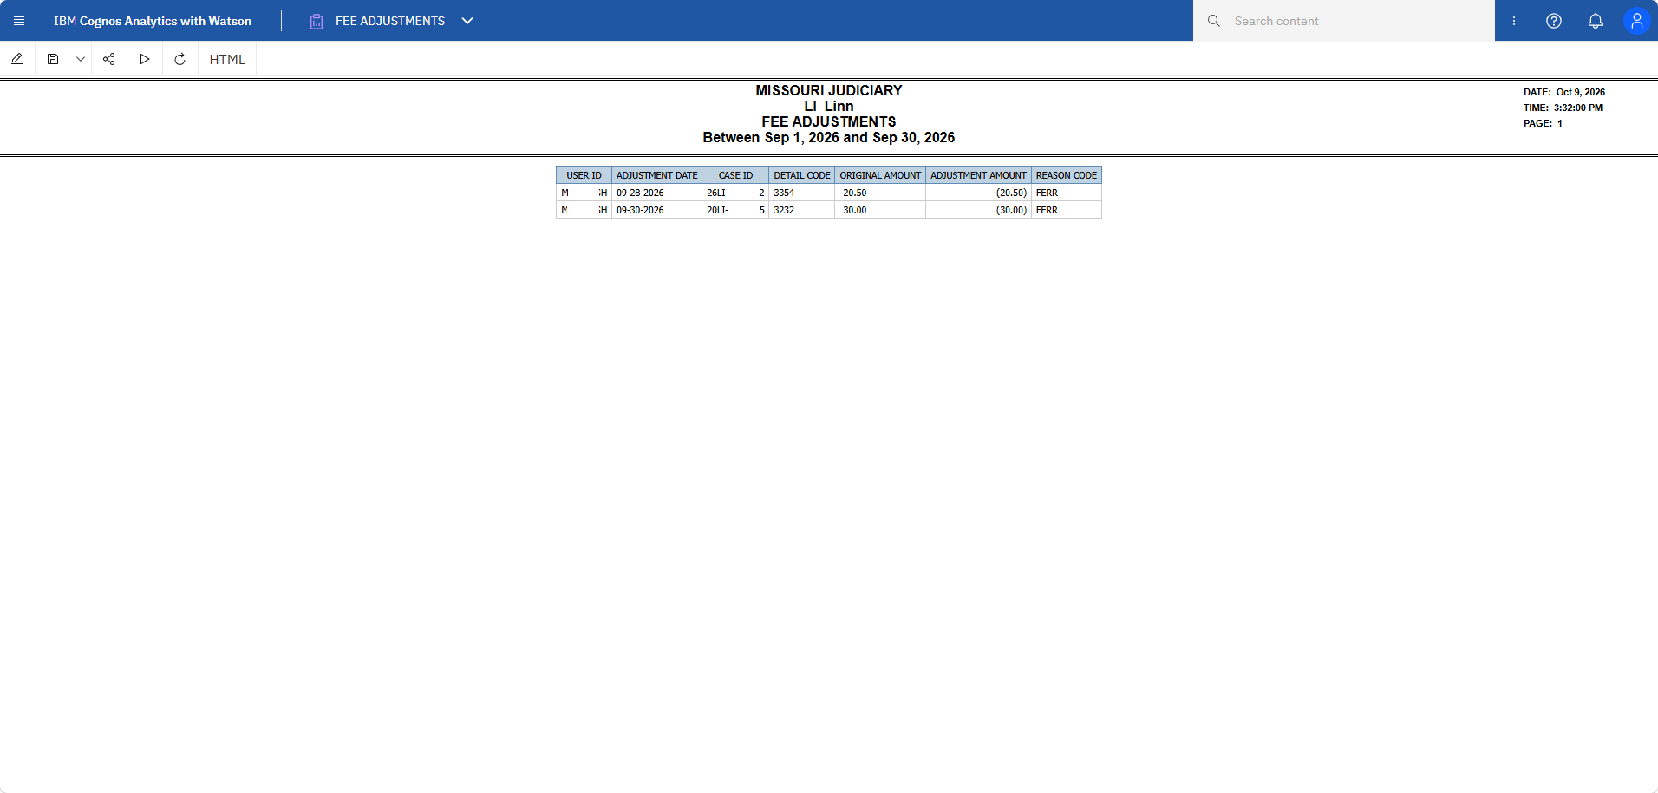
COGNOS – Fee Adjustments
Documents any Fee Adjustments completed on SMC Manage Assessments.
Team Content\JIS REPORTS\Accounting\ Management\Fee Adjustments
Select the location code for which locations you would like to run reports for.
Select Beginning Date and End Dates depending on time frame you want displayed.

Slide 17
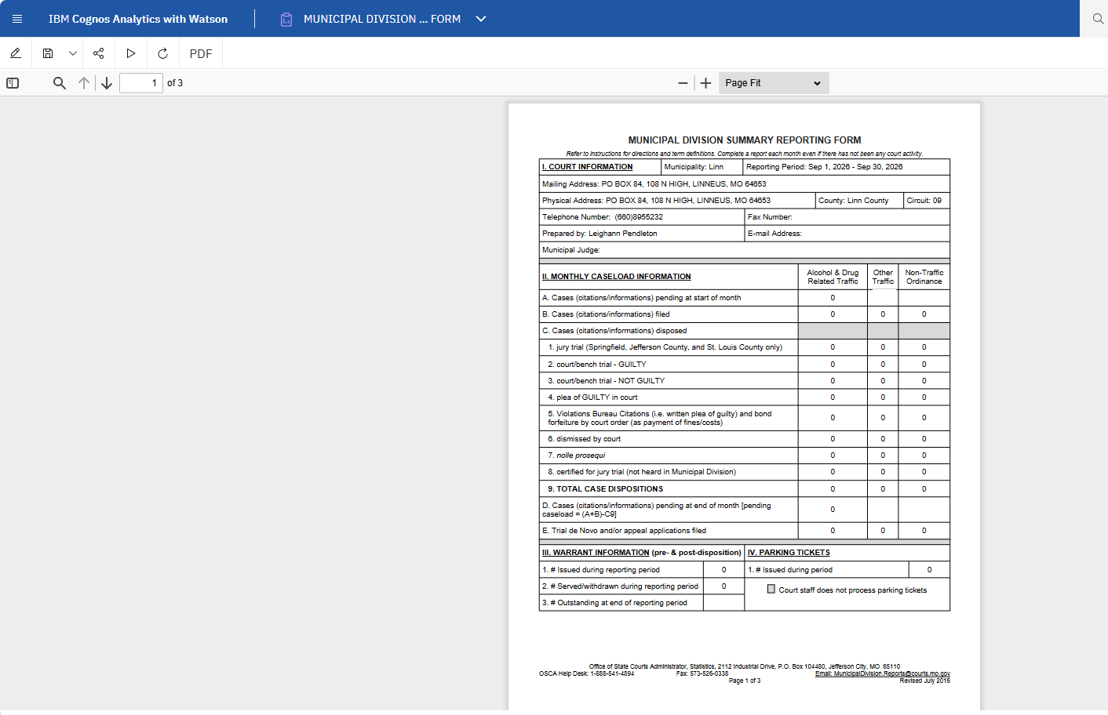
COGNOS – Municipal Division Summary Reporting Form
Documents summary case data and financial disbursements.
Team Content\JIS Reports\ Circuit Courts-All Divisions\ Management\Municipal Division Summary Reporting Form
Select Beginning Date and Ending Date for month you are reporting.
Select the location in the drop-down menu.

Slide 18
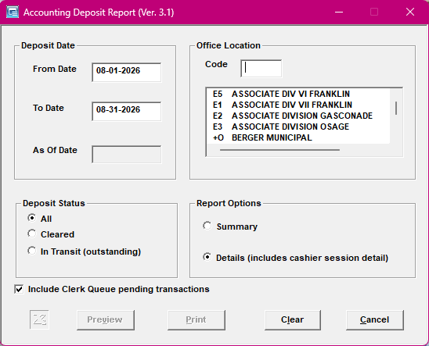
OSCA – Deposit Report
Start with the “From Date” for the first day of the month and the “To Date” to display all deposits that were cleared during that date range.
Use the Deposit report to match up that the deposit created in the month was deposited in the month being processed.
Use this report to confirm those deposits have been processed and deposited.

Slide 19
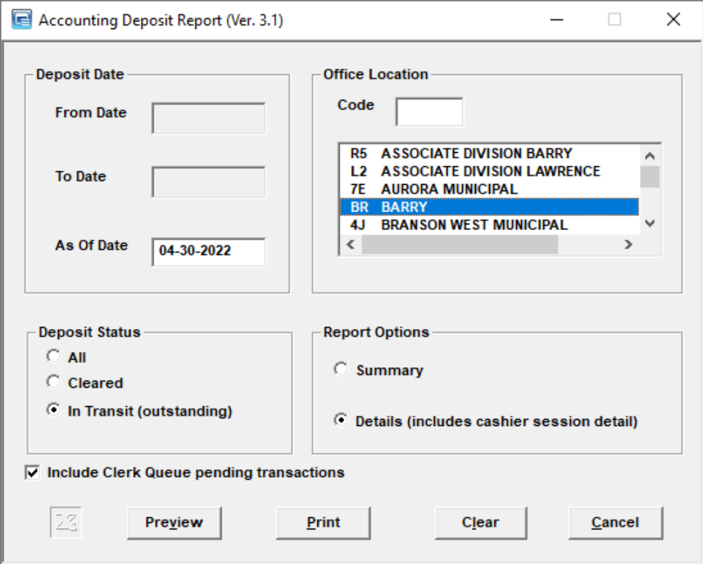
Deposits In Transit
Start with the “As Of Date” for the last day of the previous month and run individually for each location heard at the court being processed.
Use the Deposit in Transit report to match up that the deposit created in the previous month was deposited in the month being processed.
Use the Deposit in Transit report from the month being worked to confirm that deposits that have not been cleared did not get deposited. Often times, there will be deposits on the report that are dated from the beginning of the month being processed – confirm and clear in SMC if needed.
Use the Deposit in Transit report to confirm the receipts in transit listed at the end of the report.

Slide 20
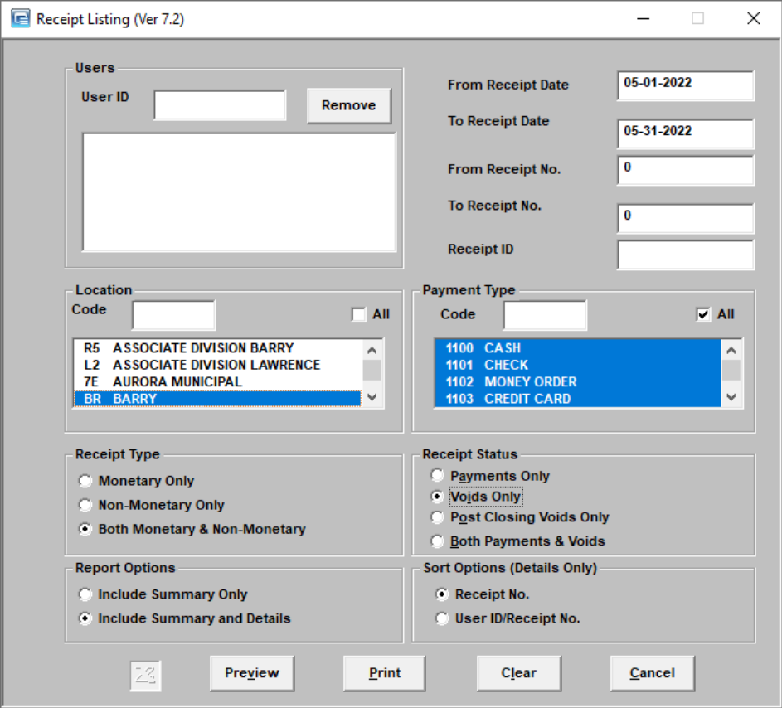
Receipt Listing
Start with the “From Date” for the first day of the month and the “To Date” to display all receipts that were taken during that date range.
Use the Receipt Listing report to match up that the receipts and deposits.
Use this report to confirm receipts were retaken when necessary.

Slide 21
JetPay Magic (Global Pay) Reports
Documents transactions regarding echecks and credit cards
There are multiple methods to run the Jet Pay Magic software to display specific information.
https://magic.collectorsolutions.com/magic-ui/Login/mo-office-of-state-courts
If you do not have a log in for case.net payments please contact the OSCA Accounting Assistance Unit

Slide 22
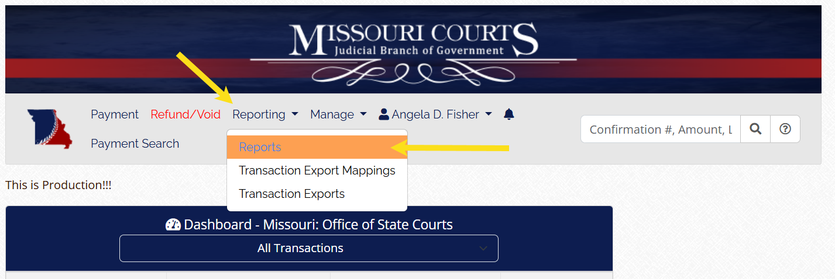
JetPay Magic (Global Pay) Reports
To access the reporting feature in the JetPay Magic online portal

Slide 23
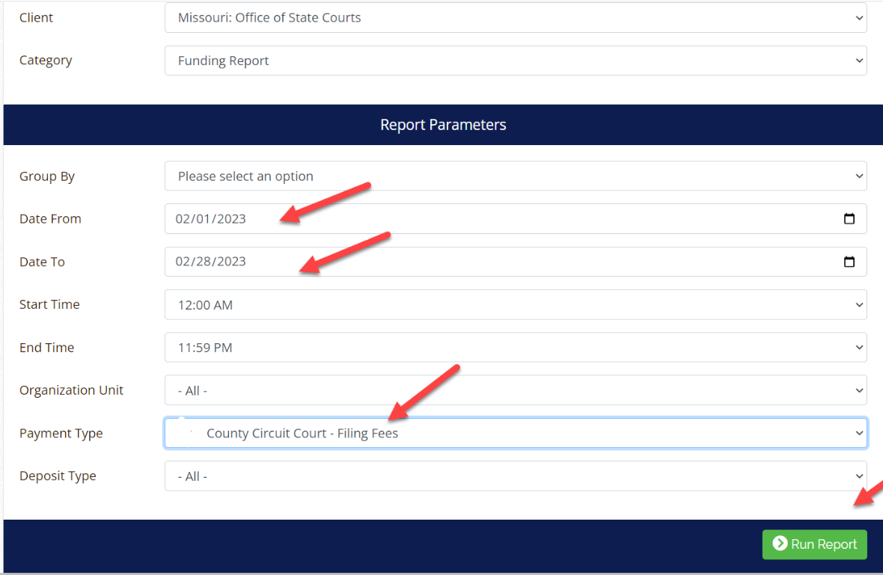
JetPay (Global Pay) Funding Report
Documents are the total echecks and credit cards for submission.
Needs to be run separately for Filing Types and Pay By Web Pay Types.
Run this for the necessary time frame

Slide 24
JetPay (Global Pay) Check Returns Report
Documents information related to any echeck that was returned during the month.
Run this from the first to the last day of the month.

Slide 25
JetPay (Global Pay) Credit Report
Documents eFiling submissions paid by eCheck or credit card that were rejected during the month.
Run from the first to the last day.

Slide 26
Quarterly or Semi-Annually Reports
At minimum Annually, but Quarterly is Best Practice
COGNOS
Cases Disposed with No Fees
Excess Revenue Exception Report
Outstanding Costs Not Associated to a Payment Plan
Outstanding Costs Not Associated to a Party
Payment Plans Without Social Security Number
Payment Plans sent to debt collection

Slide 27
Contact information
Contact information
OSCA Accounting and Court Review
Assistance Section
OSCA Help Desk
1-573-751-4377 or 1-888-541-4894,
Option 2 for Accounting Assistance Unit
Or
Email – OSCA.help.desk@courts.mo.gov

Slide 28

THANK YOU
Accounting & Court Review Assistance Section
OSCA Court Business Services Division

