Slide 1



Deborah Mitchell, JD
Separation of Power(s)

Slide 2
01
Introduction
02
What Failed
Overview
03
Constitutional Powers
04
Transferring Powers to State Government
05
Transferring Powers to City Government

Slide 3

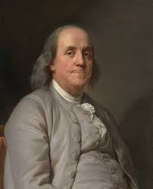
Introduction
Separation of Powers is designed to keep power from one person:
NO KINGS!
The idea came from, among other brilliant minds, the inventor of bifocals,
Benjamin Franklin, who was the oldest man in the Continental Congress during the Revolutionary War (benjamin-franklin-history.org/constitutional-convention/).

Slide 4
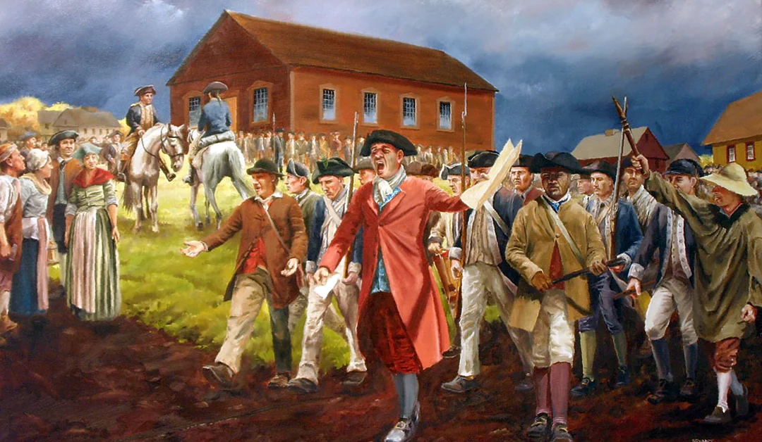
What Failed
Articles of Confederation - Adopted by Continental Congress in 1777
First attempt to create a document that joined the states in a central government
10 years later, states were refusing to be a part of the new government, and asserted their independence by doing things such as establishing their own trade agreements with other countries
A civil war almost ensued! Shay’s Rebellion pictured above.

Slide 5
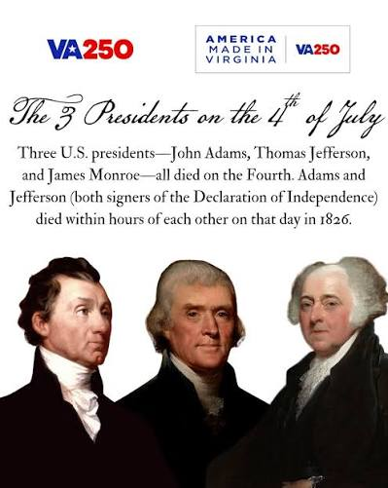
WE GET TO CONSTITUTIONAL SEPARATION OF POWERS!
1787 Constitutional Convention de-emphasized the states, instead focusing on the people in the “United States” and a centralized government designed to represent all the people.
Fearing the rise of a tyrant similar to George III, the “Founders” designed the current three branches of government.

Slide 6

Division of Powers - Stay in your Lane
Legislative branch: Article I. Congress has vast power, the most important being the “power of the purse.“ Congress also can:
  Write laws
  Levy taxes
  Borrow money
  Pay debts, and
  Declare war, among others
Executive branch: Article II. The President has power to check Congress with the veto (Congress can override!). Also:
  Commander in Chief
  Appoint members of cabinet and judiciary (Senate must approve)
  Enter treaties (with Senate approval), among others

Slide 7
Stay in your lane, cont.
Judiciary: Article III. The Constitution names the Supreme Court, and calls all other courts “inferior courts.” Thanks, guys.
Courts have the power to:
  Hear disputes between citizens of different states or between different states;
  Guarantee the right to trial by jury;
  Deal with lawsuits concerning ambassadors; and
  Determine punishment of treason, as set out in Article III.
Shortest article in the Constitution!

Slide 8
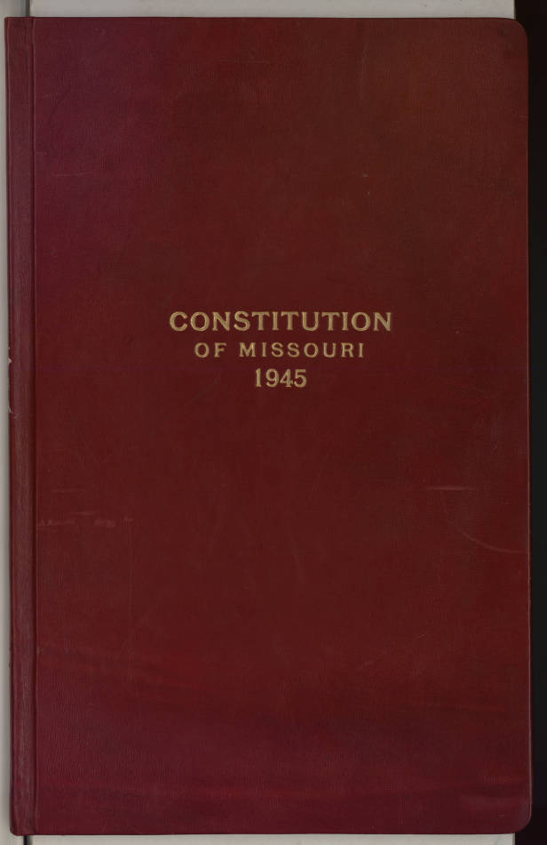
  Constitution sets out what the Federal government can and cannot do.
  Reserves rights for both the states and the people.
  Any power not specifically set out by the Constitution for the Federal government is reserved for the states or the people.
States set up governments to mirror the federal government - including Separation of Powers.

Slide 9

Back to the Benjamin
Benjamin Franklin said this: “I agree to this Constitution with all its faults, if they are such, because I think a general Government necessary for us. . .It astonishes me . . .to find this system approaching so near to perfection as it does; . . I cannot help expressing a wish that every member of the Convention who may still have objections to it, would with me, on this occasion doubt a little of his own infallibility - and to make manifest our unanimity, put his name to this instrument.”

Slide 10

The Tale of the Boxes (Lanes)
City government mirrors Federal government:
  Executive branch - Mayor and “cabinet”
  Legislative branch - City Council
  Judiciary - Municipal Court
Mayor
Council
Court

Slide 11
Do or Don’t?
  Mayor calls and wants to talk to the judge.
2. Judge receives a letter from a councilperson, who says that the case against
his neighbor for trash in the yard should be dismissed because the trash isn’t
that bad.
3. Man walks in with suspiciously fat envelope and tells you that this is for the
judge and not to tell anyone.
4. City Council orders judge to come to next council meeting to discuss the
judge’s order on a speeding case.

Slide 12
? Questions ?
???? ?????????
??? ???????????
????????

