Slide 1
Unclaimed Property
Presented by Leighann Pendleton, OSCA Accounting Assistance Unit Supervisor
Office of State Courts Administrator

Slide 2
Introduction to the Accounting Team
Angela D. Fisher – Section Manager
Court Review Assistance Unit | Accounting Assistance Unit
Edgar Castro-Corona – Supervisor | Leighann Pendleton – Supervisor
Joe Coy – Case Mgmt. Review | Mandy Cooper – Accountant
Brandon Walker – Case Mgmt. Review | Eric Bolzenius – Accountant
Drew Weber – Accountant | Jennifer Wickham – Accountant
Jesikkah Lanterman – Accountant | Kim Kliegel – Accountant
Leticia Volkart – Accountant | Jordan Brown – Accountant
 | Jack Black – Accountant

Slide 3
Today’s Agenda
Unclaimed Property

Slide 4
Accounting Responsibilities
Minimum Operating Standard # 10:
The municipal division performs monthly bank reconciliations, resolves reconciling items, and makes appropriate, documented adjustments to accounting records timely.
The municipal division prepares monthly lists of liabilities and reconciles the lists to the bank account and/or city fund balance, promptly investigates and resolves differences, and has established procedures to review the status of liabilities to determine the appropriate disposition of funds held.

Slide 5
Accounting Responsibilities
COR 4.59 | Monthly Reconciliation Records
  All bank balances and open items records shall be reconciled at least monthly. A record of the reconciliation shall be maintained in the office of the clerk of the court.

Slide 6
Unclaimed Property
Unclaimed funds addresses disposition of funds held by the court belonging to another party who cannot be located and amounts that cannot be identified to a party. In order for funds to be considered unclaimed, the court must have made a reasonable attempt to locate the owner of the funds. A reasonable attempt could include sending a letter of notification to the party or publication in the local newspaper.

Slide 7
Unclaimed Property
Although unclaimed funds may be remitted earlier, if the funds are unclaimed for at least three years, one year for cash bond fund, the funds are considered abandoned and must be sent to the Unclaimed Property Division of the Missouri State Treasurer's Office.
Records documenting the owner(s) of property turned over to the state should be retained for at least five years after the date the funds are sent to the state.

Slide 8
Returned Checks
Returned checks should be reissued to the address provided by USPS on the yellow sticker when one is provided. If the court is unable to obtain an accurate address and all reasonable attempts have been made, the court may then turn the funds over to Unclaimed Property.

Slide 9
Stale Checks
Stale checks, or checks that have not cleared the court’s bank account, are considered unclaimed funds. These checks should be voided and reissued to Unclaimed Property.
If payment was issued to a law firm – void and replace the check and send along with notice to inform the law firm that this is a reissued check for one that has not been cashed.

Slide 10

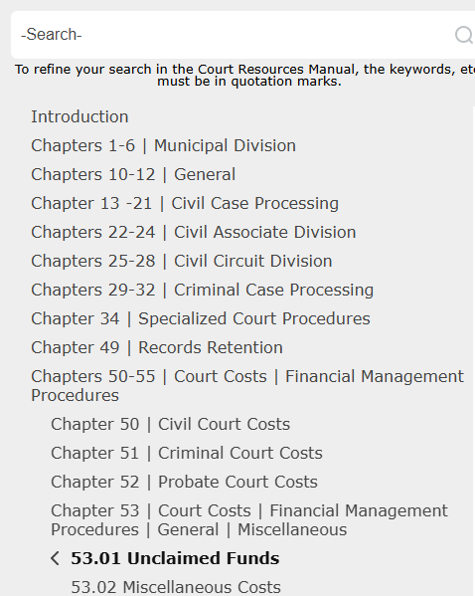
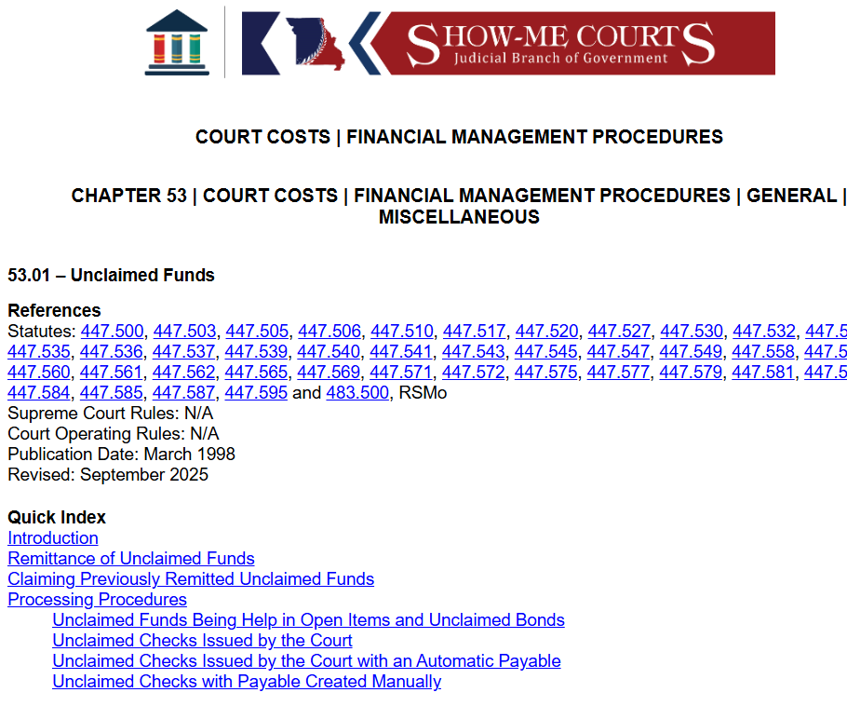
Unclaimed Property Information
Court Resources
  Chapter 53/Court Costs/Financial Management Procedures/General/Miscellaneous/Unclaimed Funds

Slide 11
Remittance of Unclaimed Funds
What are unclaimed funds?
  Unclaimed funds can include stale, outstanding checks and bonds where the court cannot locate the bond refund party, and unidentified funds held in the court’s bank account.

Slide 12
Remittance of Unclaimed Funds
Where do I send unclaimed funds?
  When remitting unclaimed funds, complete the Unclaimed Property Report form and include it with the check to the Missouri State Treasurer-Unclaimed Property Division. The form and unclaimed funds should be remitted no less than annually by November 1st .
  Website: www.treasurer.mo.gov
  Address: Missouri State Treasurer's Office, Unclaimed Property Division, P. O. Box 1272, Jefferson City, MO 65102-1272
  Funds maybe submitted on one check to the Missouri State Treasurer

Slide 13
Processing Procedures
The funds may be held in the court account until the time limits have been reached, or after reasonable attempts to locate the party have failed, the court can remit the funds to the state earlier if desired.
Depending on the type of money, and how it was handled in SMC, the procedures to disburse the money to the Unclaimed Property Division property will vary.
If your circumstances are different from the ones listed, contact the OSCA Helpdesk and request assistance from the Accounting Assistance Unit.

Slide 14
Procedure Scenarios
Unclaimed Funds Being Held in Open Items and Unclaimed Bonds
Unclaimed Checks Issued by the Court
Unclaimed Checks Issued by the Court with an Automatic Payable
Unclaimed Checks with Payable Created Manually

Slide 15
Unclaimed Funds Being Held in Open Items and Unclaimed Bonds
Add additional cost assessed
Use Detail code: 5064 – Unclaimed Property
Enter the amount to be remitted
Enter the payee organization name for State Treasurer – Unclaimed Property Division (UNCLAIMED)
Receipt payment: 2101 – Open Items Out, or 9206 – Bond Applied
Issue the recipient check

Slide 16
Unclaimed Checks Issued by the Court
Void the check
Void the receipt (if receipt has not created additional checks)
NOTE: if more than one payable was created by this receipt – please contact AAU
Receipt payment
  2101 – Open Items Out
  8206 – Bond Applied
Select the Open Manage Overpayments checkbox
Enter the organization name for State Treasurer – Unclaimed Property Division as the refund payee (UNCLAIMED)
Issue the recipient check

Slide 17
Unclaimed Checks Issued by the Court with an Automatic Payable (If payee is added in manage assessment)
Void the check
Void the payable: APDC 7508 (Recipient Pay Detail Code)
Review the SMC Reports – Case Party Fee Report for cost detail code for the voided check (5XXX)
Create a manual payable
Enter the payee organization name for State Treasurer – Unclaimed Property Division (UNCLAIMED)
Use the appropriate (6XXX) Payable Code/Description for the cost detail code (5XXX) above
Enter the payable amount
Print the check

Slide 18
Unclaimed Checks Issued through overpayment receipting
Void the check
Review the SMC Reports – Case Party Fee Report to determine receipt number to be voided that created the overpayment
Void the receipt containing the overpayment
Retake receipt (exactly as it was originally taken)
Process overpayment on the receipt retake to UNCLAIMED
Print the check

Slide 19
Unclaimed Checks with Payable Created Manually
The following procedures should be used for checks with payables created manually in SMC Payable Creation and Maintenance. The payables will not have a receipt associated to the payable.
Void the check
Void the payable
Create a manual payable with the same DETC code as the original payment
Payable to UNCLAIMED
Print the check
Complete Unclaimed Property Report form

Slide 20
Claiming previously remitted unclaimed funds
In order to claim funds previously remitted to the Unclaimed Property Division of the State Treasurer’s office, the party should contact that office. The judge may also send a letter to the Division of Unclaimed Property requesting that the funds be returned to the court.
Attempt to notify the party
  Use the NOTIC – Notice docket code

Slide 21
Notify Bank
When processing unclaimed – make sure that stop payments have been completed with the bank to ensure that the original check is not cashed.
Note most banks only do a stop payment for 6 months. If using positive pay put these checks in the “do not honor” category.

Slide 22
Notes to Add
All outstanding checks should be reviewed no less than quarterly to ensure checks written to governmental entities and attorneys are being cashed in a timely fashion. Funds written to government/attorneys typically do not get sent to unclaimed property.

Slide 23
Notes to Add
As much as possible – allow SMC to create the payable through the receipting process. This will ensure that funds are processed out of the correct DETC.

Slide 24
Need Help?
  If there are situations regarding unclaimed property that are not outlined – Please contact the OSCA Accounting Assistance Unit.
  Call the OSCA Help Desk and ask for the Accounting Assistance unit.
  OSCA Help Desk | (888) 541-4894 | (573) 751-4377
  OSCA.Help.Desk@courts.mo.gov

Slide 25
Contact information
Contact information
OSCA Accounting and Court Review
Assistance Section
OSCA Help Desk
1-573-751-4377 or 1-888-541-4894,
Option 2 for Accounting Assistance Unit
Or
Email – OSCA.help.desk@courts.mo.gov

Slide 26

THANK YOU
Accounting & Court Review Assistance Section
OSCA Court Business Services Division

