Slide 1
Budgets
Jeff Chapple
O’Fallon Municipal Court Administrator

Slide 4
Municipal Court Budgets
Who’s responsibility
Timelines and Formats
COR 13
Judicial Finance Commission Report
Other Resources

Slide 5
Who’s Responsibility
For expenses it is the Municipal Courts
Court Administrator
Judge
For revenues I have always deferred to the City’s Finance department
Our Job is to adjudicate cases not predict revenues.

Slide 6
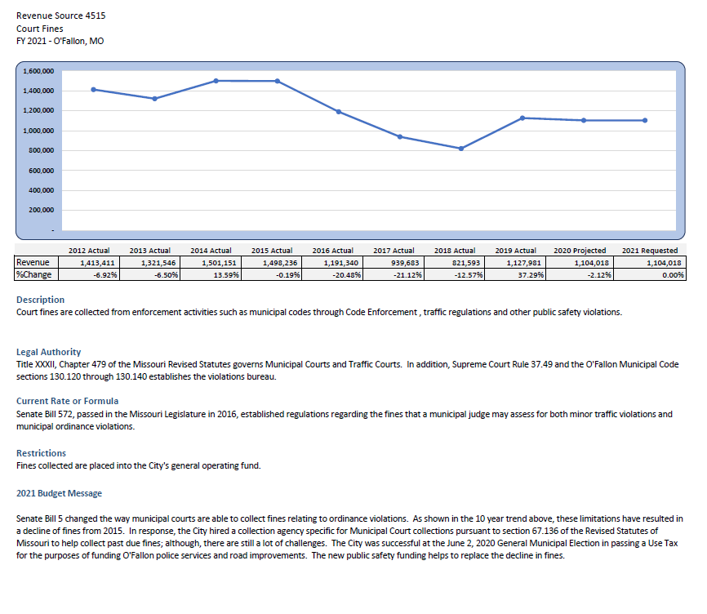

Slide 7
Timelines and Formats
Finance usually sets.
We are Calendar year and begin in July/August with September/October deadlines
Format is usually set by Finance as well
Excel or Financial Software

Slide 8
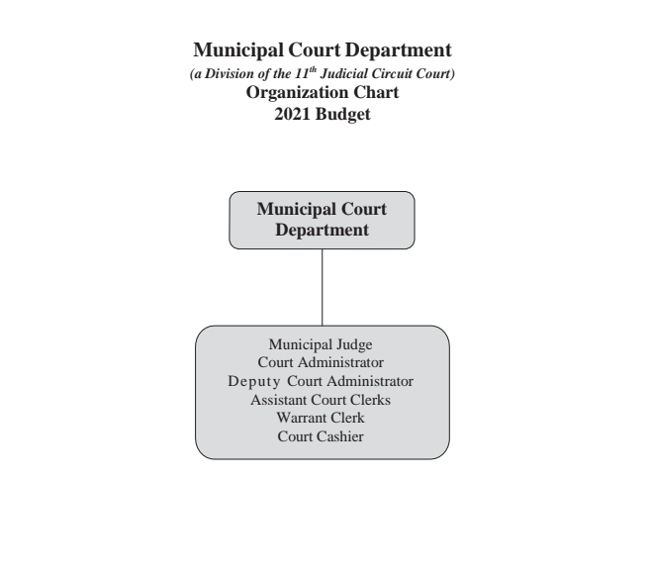

Slide 9
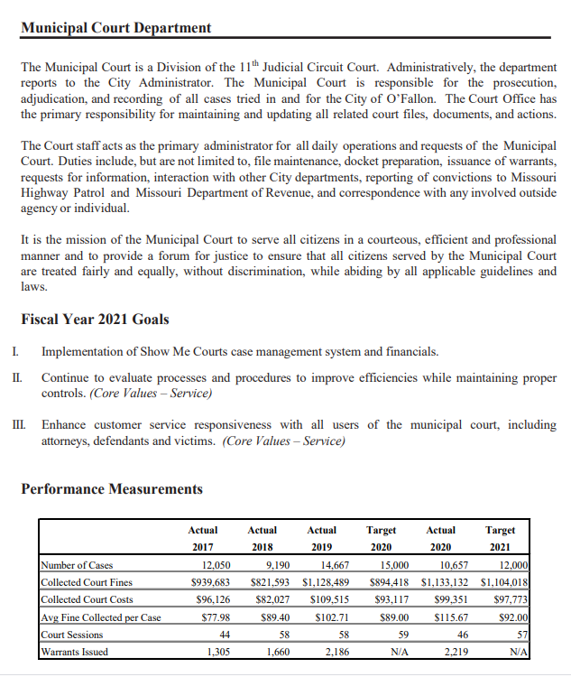

Slide 10
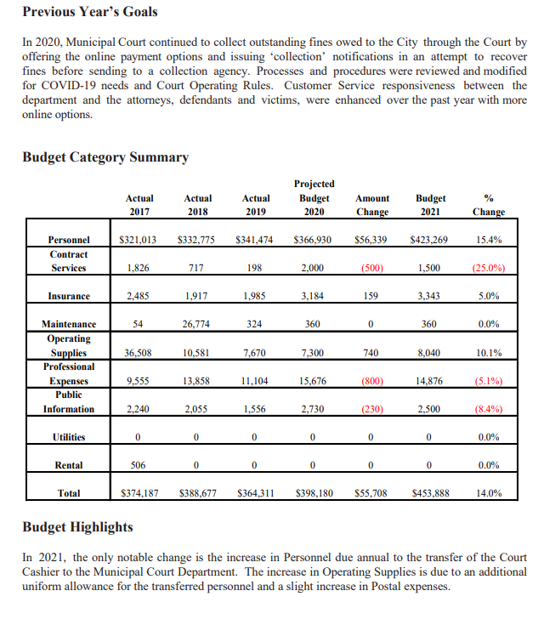

Slide 11
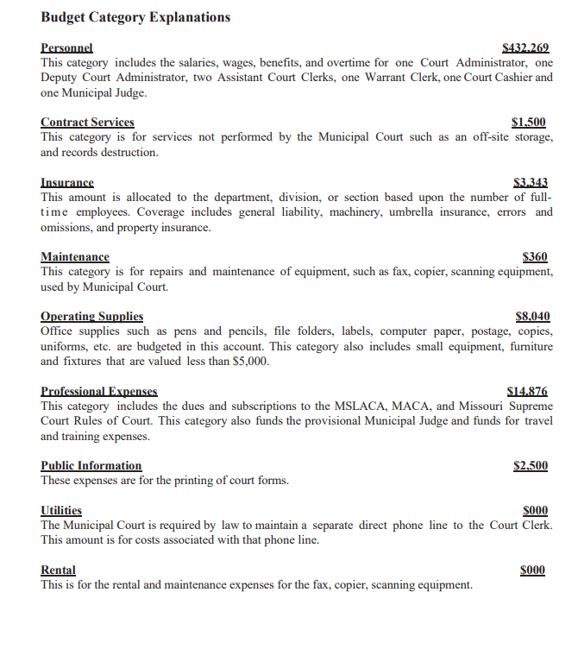

Slide 12
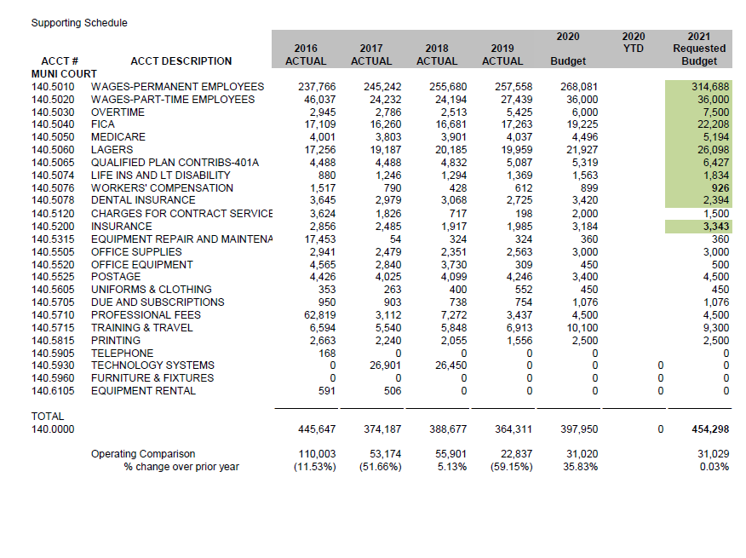

Slide 13
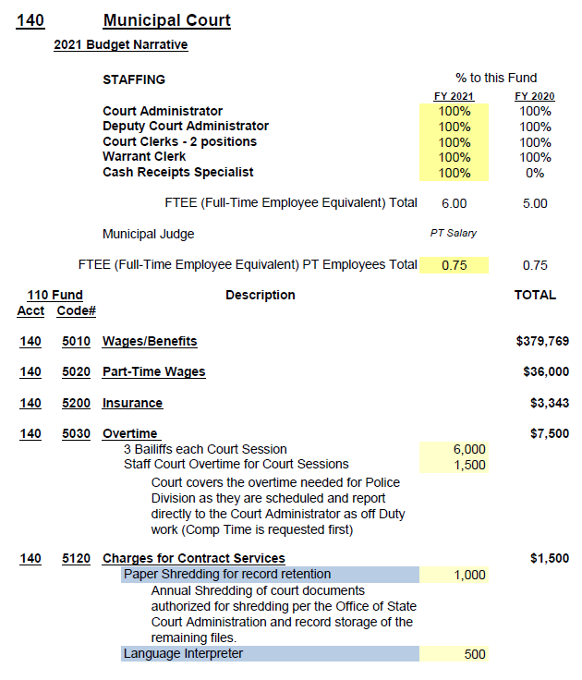

Slide 14
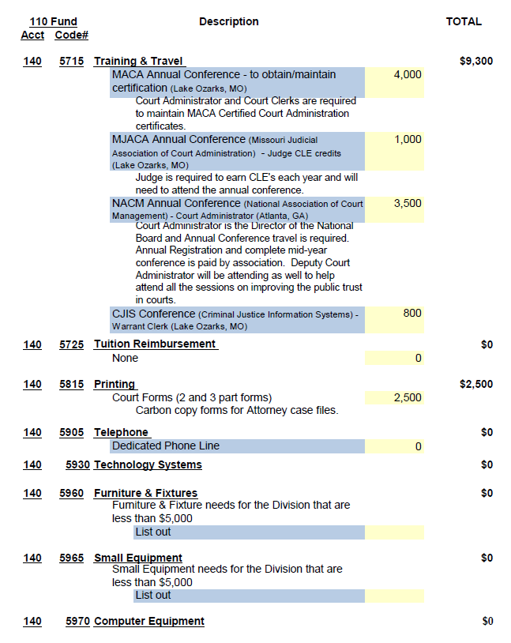

Slide 15
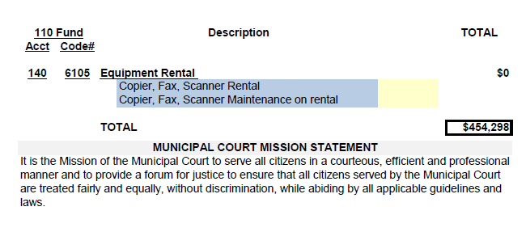

Slide 17
Next Steps
Present to Council
Voting as Ordinance
Challenges to Budgets

Slide 18
13.01 Municipal Budget Disputes
If a municipality and the municipal division of the circuit court are unable to resolve a budget dispute, either party may file a request with the presiding judge for a settlement conference. The presiding judge shall promptly schedule the conference at which the municipal division shall have the burden of proving that the budget request is reasonable. Following the conference, the presiding judge shall issue written recommendations to the parties to the conference. (Approved for publication Aug. 21, 1995.)

Slide 19
13.02 Review of the PJ Recommendations
The municipality may seek review of any recommendation of the presiding judge regarding the municipal division's budget request by filing a petition for review with the municipal finance commission. The members of the judicial finance commission shall constitute the municipal finance commission. The municipal division shall have the burden of proof before the commission that the budget request is reasonable. When a petition for review is filed, the municipal finance commission shall consider the petition in the manner prescribed by section 477.600, RSMo. Review of the commission's decision shall also be as prescribed by section 477.600, RSMo. (Approved for publication Aug. 21, 1995.)

Slide 21
Judicial Finance Commission Report
RSMo 477.600
March every year
Form requirements
Non-State Funding Personnel
Non-State funded Expenditures
Other Funding

Slide 22
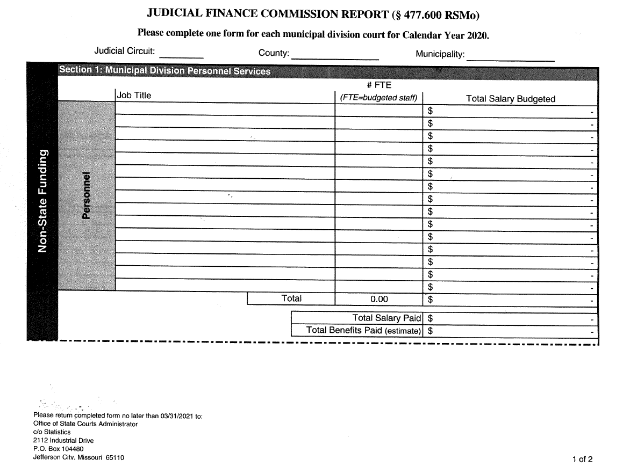

Slide 23
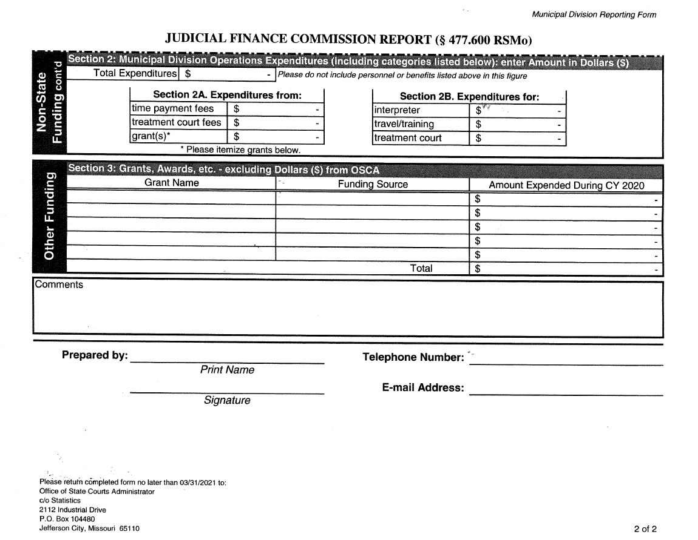

Slide 24
Other Resources
#1 each other NETWORK and Share
GFOA
OSCA

Slide 25
